Slide 1
Stroke pathiophysiology, etiology and management
Alejandro Magadán, M.D.
THD Medical Resident Lecture
Neurology Consultants of Dallas

Slide 2
I have no disclosures

Slide 3
Goals
Review stroke demographics
Review stroke syndromes
Understand the goals of a code stroke
New (sort of new) news in acute stroke treatment
Secondary stroke prevention

Slide 4
Stroke Incidence
795,000 new strokes per year
610,000 are new strokes and 185,000 recurrent
87% are ischemic, 10% are intracranial hemorrhage and 3% are subarachnoid
on average there is a stroke every 40 seconds
15% of all strokes are heralded by a TIA

Slide 5
Stroke Subtypes
Ischemic stroke
Hemorrhagic stroke
Subarachnoid Hemorrhage
Venous sinus thrombosis

Slide 6
Focus
Ischemic Stroke
Hemorrhagic Stroke (ICH)

Slide 7
Hemorrhagic Stroke
Hemorrhagic stroke occurs with disruption of the blood vessels
Most common cause is malignant hypertension
Underlying tumor, AVM, cerebral amyloid angiopathy and sympathomimetic drug use also may be potential causes

Slide 8
Common locations for ICH
Putamin (BG)
Thalamus
Pons
Cerebellum
Lobar white matter

Slide 9
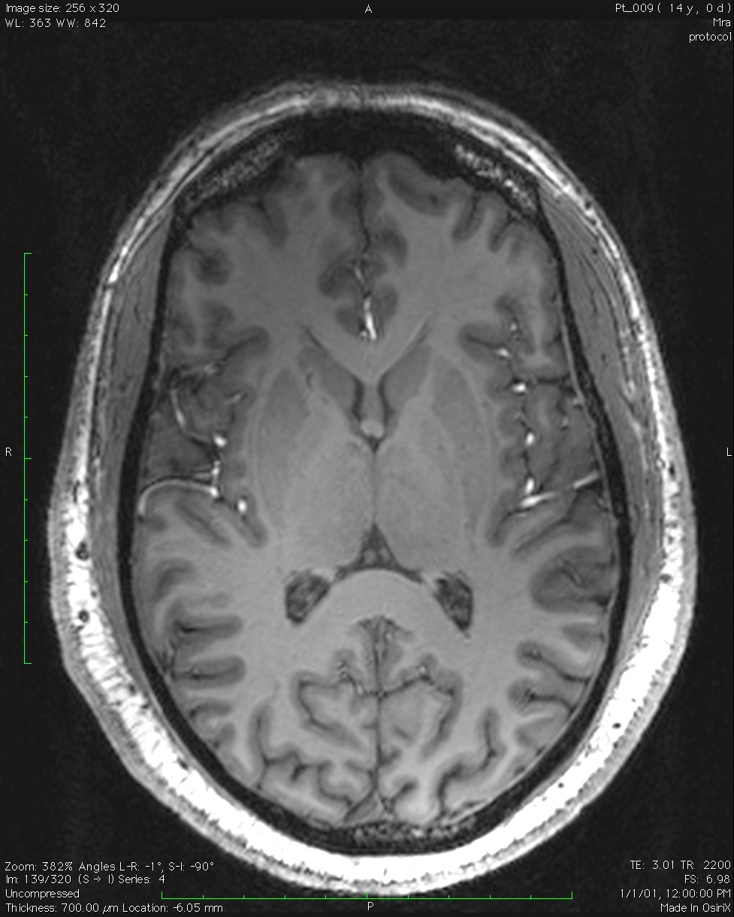
Putamen
Thalamus
Lobar White Matter

Slide 10
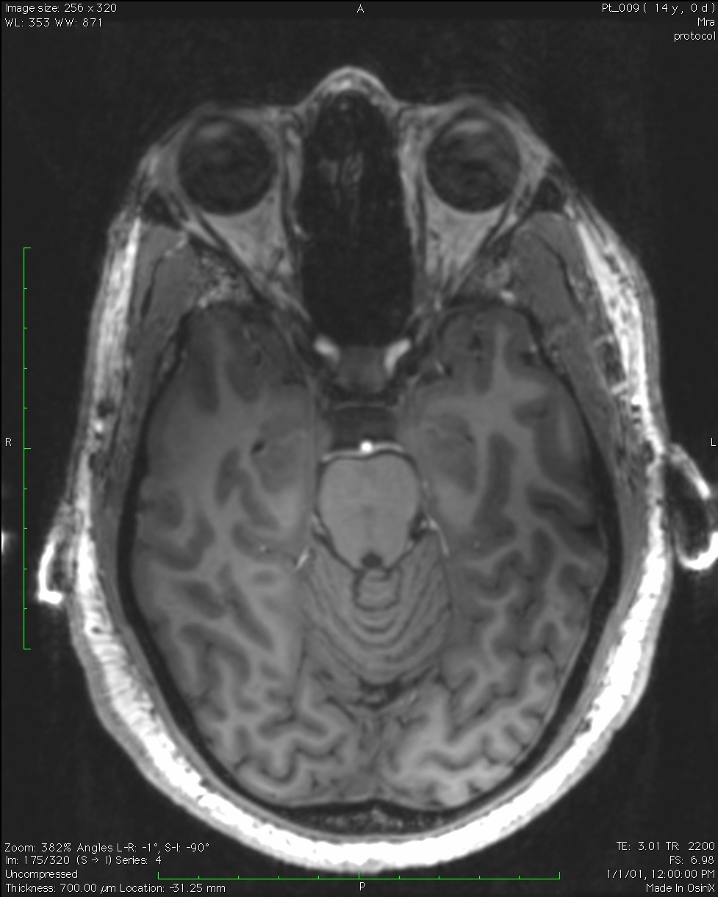
Pons
Cerebellum

Slide 11
Management of ICH
Stabilization of vital signs
Rapid Blood pressure control
Maintain normothermia
Reversal of anticoagulants if they are taken
Ultimately transfer to Stroke Unit or Critical Care unit
Frequent vital sign and neurochecks until stable
Serial imaging

Slide 12
ICH and blood pressure control
INTERACT-2 study did not find a decreased rate of death or disability but did note a decreased in the mRS (<140 mmHg vs < 180 mmHg) (NEJM 2013; 368:2355-65)
ATATCH-2 Found that lower blood pressure to a target 110-139 mmHg did not lower death rate or disability compared to 140-179 mmHg(NEJM 2016;735:1033-43)

Slide 13
ICH and Hemostatic therapy
FAST trial did not find activated factor VII reduced mortality or disability had had a small reduction in hematoma volume (NEJM 2008;358:2127-2137)
PATCH trial demonstrated worse outcomes and increased adverse events 42% vs 29% in platelet transition compared to placebo. (Lancet 2016 June 25;387:2605-2613)

Slide 14
ICH and anticoagulation
Warfarin standard of care is to give vitamin K and prothrombin complex concentrate (favored over fresh frozen plasma
Dabigatran (is a direct thrombin Factor II inhibitor) has idarucizumab as a reversal agent, a pharmacologic reversal, no clinical outcomes evaluated (NEJM 2015; 373:511-520)
ANNEXA-4 study also with pharmacologic reversal of rivaroxaban, apixiban, edoxaban Factor Xa inhibitors(NEJM 2019;380:1326-1335)

Slide 15
ICH and surgical management
CLEAR III trial was safe but provided no improvement in functional outcome or mortality with intraventricular catheter and alteplase irrigation(Lancet 2017 Feb 11; 389:603-611)
MISTIE III trial was safe but also had no improvement in functional outcome or mortality vs standard medical care with intraparynchemal catheter infusion of alteplase and aspiration of blood (Lancet 2019 Mar 9; 393:1021-1032)
STITCH II trial was safe but early (<12 hours) surgical hematoma evacuation of superficial lobar hemorrhages did not improve mortality or disability compared to medical management (Lancet 2013 Aug 8;382:397-408)

Slide 16
Small vessel disease

Slide 18

Microatheroma

Slide 19
Microatheroma

Slide 20
Microatheroma

Slide 21
Hyalinosclerosis

Slide 22
Hyalinosclerosis

Slide 23
Lipohyalinosis

Slide 24
Lipohyalinosis

Slide 25
Lipohyalinosis

Slide 26
Lipohyalinosis

Slide 27

Eponym/Artery | Anatomy | Symptoms | Arterial Supply | Tracts
Ataxic hemiparesis | Posterior Limb of the internal capsule/basis pontis | Contralateral arm and leg weakness and ataxia | Lenticulostriates | Cortical spinal Tracts
Pure Motor Hemiparesis/dysarthric hemiparesis | Posterior limb of the internal capsule, ventral pons, cerebral peduncle, hemispheric white matter | Contralateral arm and leg weakness and dysarthria | Lenticulostrites/small penetrating arteries | Cortical spinal tracts
Clumsy hand syndrome | Genu of the internal capsule | Contralateral loss of hand fine motor skills and dysarthria | Lentoculostriates | Cortical spinal tracts

Slide 28
Eponym/Artery | Anatomy | Symptoms | Arterial Supply | Tracts
Sensory motor stroke | Anterolateral thalamus and posterior internal capsule | Contralateral sensory loss and weakness | Perforators off of anterior choroidal artery | Cortical spinal and thalamospinal
Pure sensory stroke | Ventral posterior thalamus | Contralateral sensory loss | Thalamic perforators | Thalamospinal tracts
Clumsy hand syndrome | Genu of the internal capsule | Contralateral loss of hand fine motor skills and dysarthria | Lentoculostriates | Cortical spinal tracts
Dejerine-Roussy syndrome/Thalamic pain syndrome | thalamus | contralateral hemi-sensory loss to all modalities and hemi-body pain | Thalamic Perforators | Spinothalamic tracts

Slide 29
Eponym/artery | Anatomy | Symptoms/signs | Artery | Tracts
Parinaud syndrome | Dorsorostral midbrain, posterior commissure | Paralysis of up gaze, convergence-retraction nystagmus, lid retraction light near dissociation | PCA: Penetrating arteries | CN III and nucleus
Weber syndrome | Midbrain | Contralateral weakness and ipsilateral third nerve palsy | PCA: Penetrating arteries | Cortical Spinal CN III
Claude Syndrome | Midbrain, tegmentum | Contralateral arm and leg ataxia, ipsilateral third nerve palsy | PCA: Penetrating arteries | Cortical Spinal CN III
Benedikt syndrome | Midbrain, tegmentum, red nucleus, III nucleus, cerebral peduncles | Ipsilateral III nerve palsy, contralateral arm and leg weakness and ataxia | PCA: Penetrating arteries | Cortical Spinal CN III
Internuclear ophthalmoplegia | Pontine/midbrain medial longitudinal fasiculus | Ipsilateral adduction palsy, with contralateral gaze nystagmus | Basilar: Penetrating arteries | Medial Longitudinal Fasiculus

Slide 30
Eponym/Artery | Anatomy | Signs/Symptoms | Arterial Supply | Tracts
One and one half syndrome | Paramedian pontine reticular formation or VI and MLF | Ipsilateral horizontal gaze palsy, contralateral medial gaze palsy | Paramedian pontine penetrators | Paramedian Pontine Reticular Formation
Raymond syndrome/Basilar paramedian pontine branches | ventral medial pons | Ipsilateral VI palsy, contralateral weakness, spares face (VII) | Paramedian pontine penetrators | CN VI and cortical spinal tracts
Millard-Gublier syndrome/Basilar short and paramedian branches | Basis pontis, fascicles of VI and VII | Contralateral weakness, ipsilateral VI and VII palsy | Paramedian pontine penetrators | CN VI, VII and cortical spinal stracts
Marie-Foix syndrome/ Basilar&AICA | lateral pons, middle cerebellar peduncle | Ipsilateral ataxia, contralateral arm and leg weakness and hemisensory loss to pain and temperature | Basilar artery Long circumferential branches AICA | Cerebellar Corticospinal Spinothalamic
Foville Syndrome | Inferior Pons (PPRF, VI and VII nuclus/fascicle) | Ipsilateral gaze palsy, isilateral facial nerve palsy, hemisensory loss, contralateral hemiparesis | Basilar artery : pontine paramedian perforators, short circumferential arteries | PPRF, CN VI, VII Spinothalamic tracts Cortical spinal tracts

Slide 31
Large Artery disease

Slide 32
Pathogenesis of large artery atherosclerosis
Endothelial injury
Migration of macrophages into site of injury
Formation of a fatty streak
Deposition of foam cells
Continued inflammation
Continued deposition of foam cells
Stenosis and/or occlusion
Ulceration of plaque and emboli formation

Slide 33
Pathogenesis of Large Artery Atherosclerosis

Slide 34
Pathogenesis of Large Artery Atherosclerosis

Slide 35
Pathogenesis of Large Artery Atherosclerosis

Slide 36
Pathogenesis of Large Artery Atherosclerosis

Slide 37
Pathogenesis of Large Artery Atherosclerosis

Slide 38
Pathogenesis of Large Artery Atherosclerosis

Slide 39

Pathogenesis of Large Artery Atherosclerosis

Slide 40
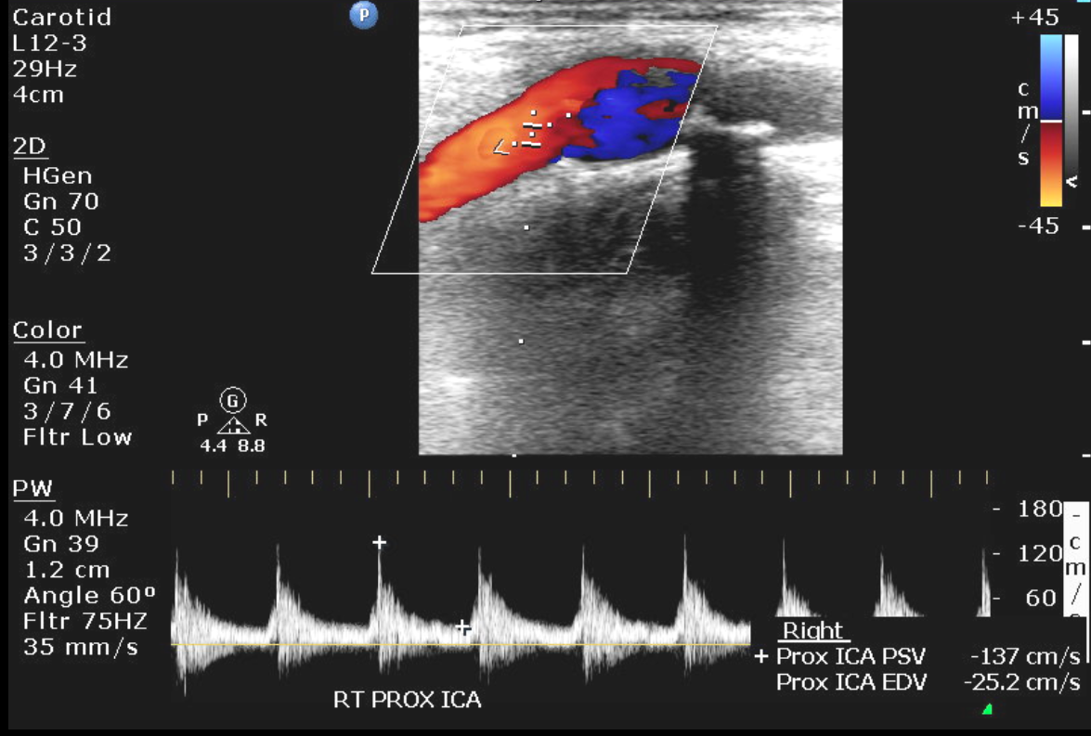


Slide 41
Pathogenesis of Large Artery Atherosclerosis

Slide 42
Pathogenesis of Large Artery Atherosclerosis

Slide 43
Pathogenesis of Large Artery Atherosclerosis

Slide 44
Pathogenesis of Large Artery Atherosclerosis

Slide 45
Eponym/Artery | Anatomy | Symptoms/Signs | Artery | Tracts
Gerstmann syndrome/partial MCA | dominant parietal lobe | agraphia/acalculia/right left confusion, finger agnosia apraxia | Inferior Branch M2
Alexia without agraphia | Dominant occipital lobe and splenum of the corpus callosum | alexia(splenum of the corpus callosum) contralateral homonymous hemianopsia(occipital lobe) | PCA
Balint syndrome | bilateral parietal/occipital lobes | Optic ataxia, ocular apraxia, asimultagnosia | Bilateral PCA
Anton syndrome | bilateral occipital lobes | Cortical blindness, denial and possible hallucinations | Bilateral PCA

Slide 46
Eponym/Artery | Anatomy | Signs/Symptoms | Arterial Supply | Tracts
Wallenberg, lateral medullary syndrome | Lateral medulla | Ipsilateral hemi-sensory loss of face , facial pain, gait ataxia, nystagmus, vertigo, hoarseness, dysphagia, Horner’s and contralateral hemi-sensory loss | Vertebral artery>PICA | V Vestibular Nucelus Nucleus accumbens Descending sympathetic chain
Anterior spinal artery syndrome | Anterior spinal cord | Paraparesis or paraplegia | Artery of Ademkovich
Top of the Basilar | Midbrain, thalamus, medial temporal lobes and occipital lobes | Mid-position and dilated pupils III or partial 3rd, VI palsy, vertical gaze palsy, hyper-somnolence, amnesia | Midbrain penetrators, bilateral PCA’s and thalamic perforators | Reticular Activating System
Dejerine syndrome/medial medullary syndrome | Medullary pyramid, medial lemniscus and hypoglossal nerve | Tongue deviated ipsilaterally, contralateral weakness, contralateral hemisensory loss | Vertebral Artery: Anteromedial artery Anterior spinal artery | Pyramidal tracts Medial Lemniscus CN XII
Locked in | Pons | Quadraparesis, bilateral facial weakness, horizontal gaze palsy, dysarthria | Basilar | Corticalspinal Corticalbulbar Bilateral Facicles of VI

Slide 47
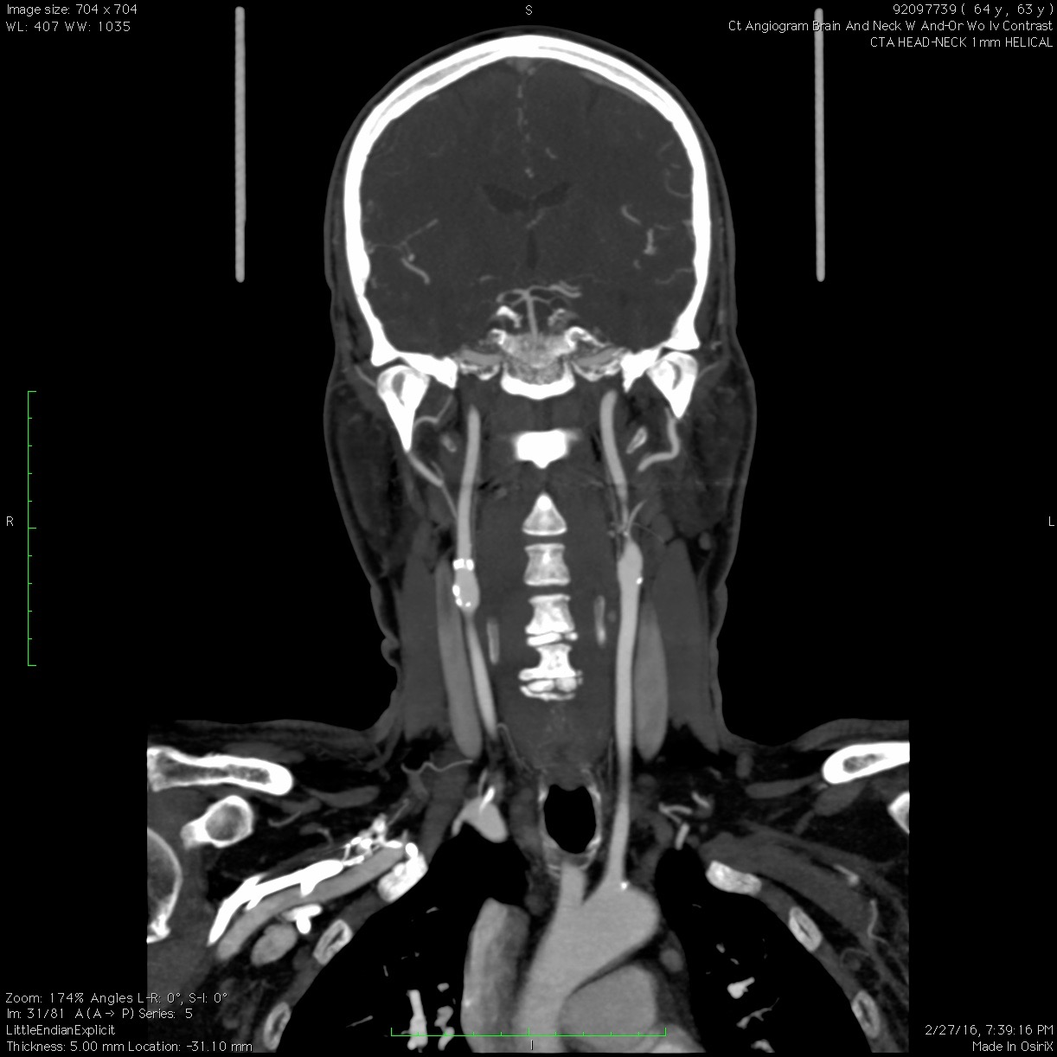
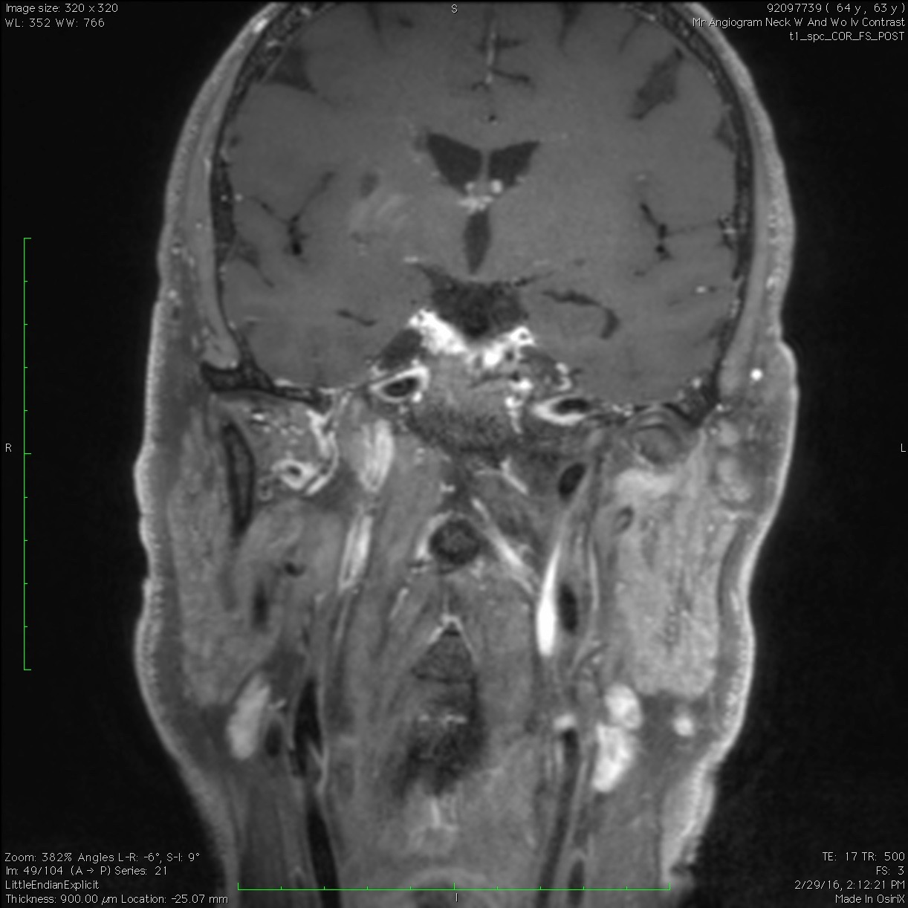

Slide 48
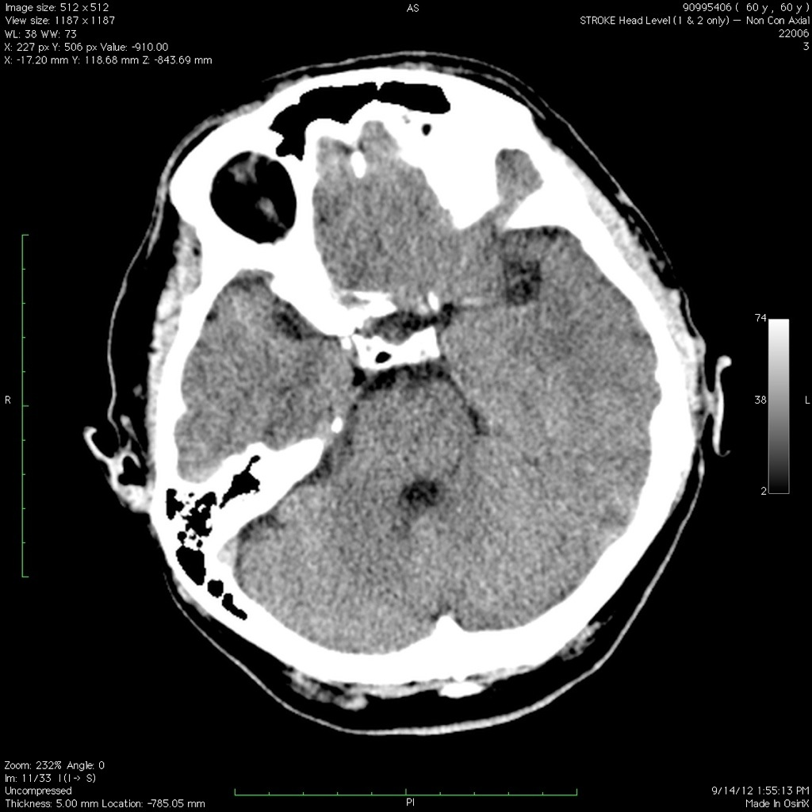
60 y/o male found on a bus bench, not talking and not moving his right side

Slide 49
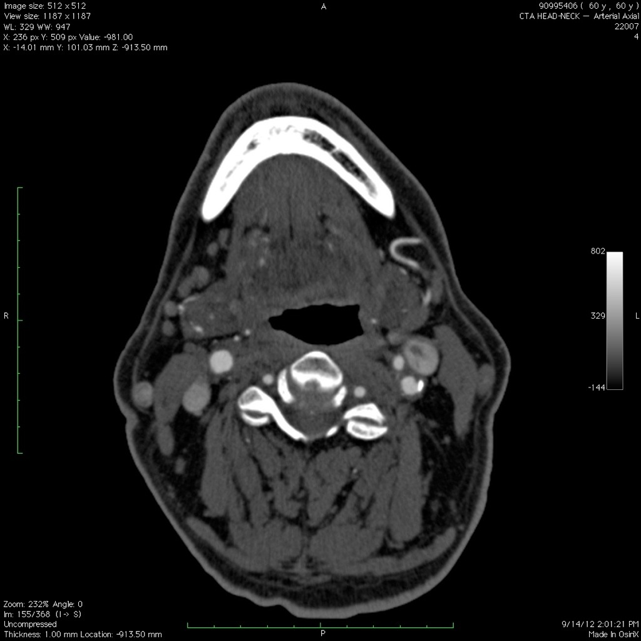

Slide 50
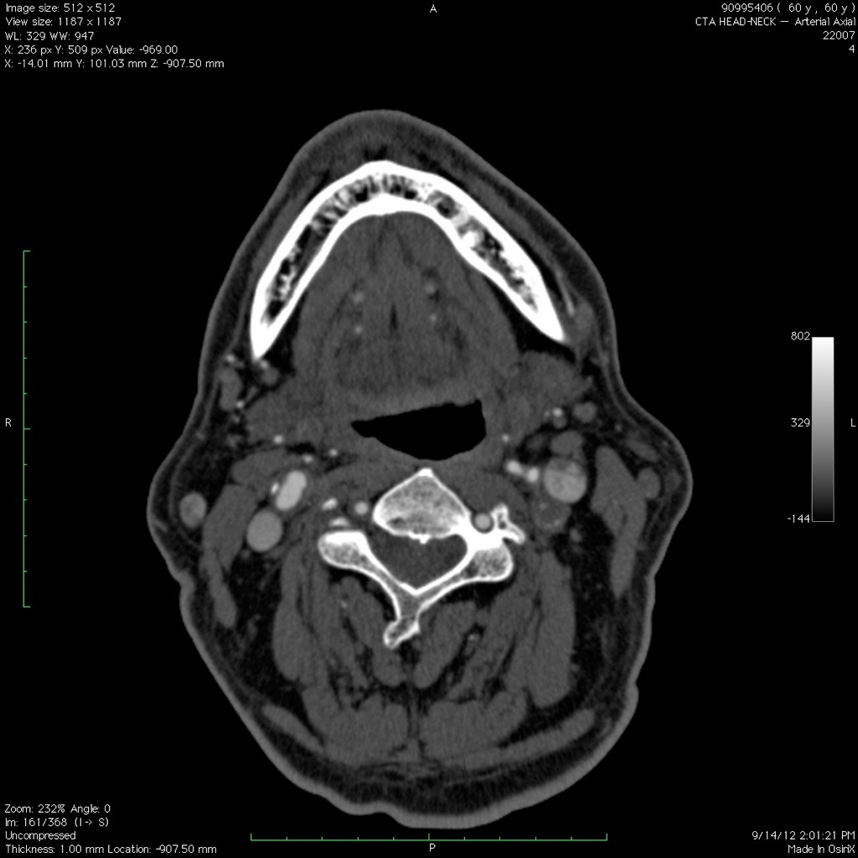

Slide 51
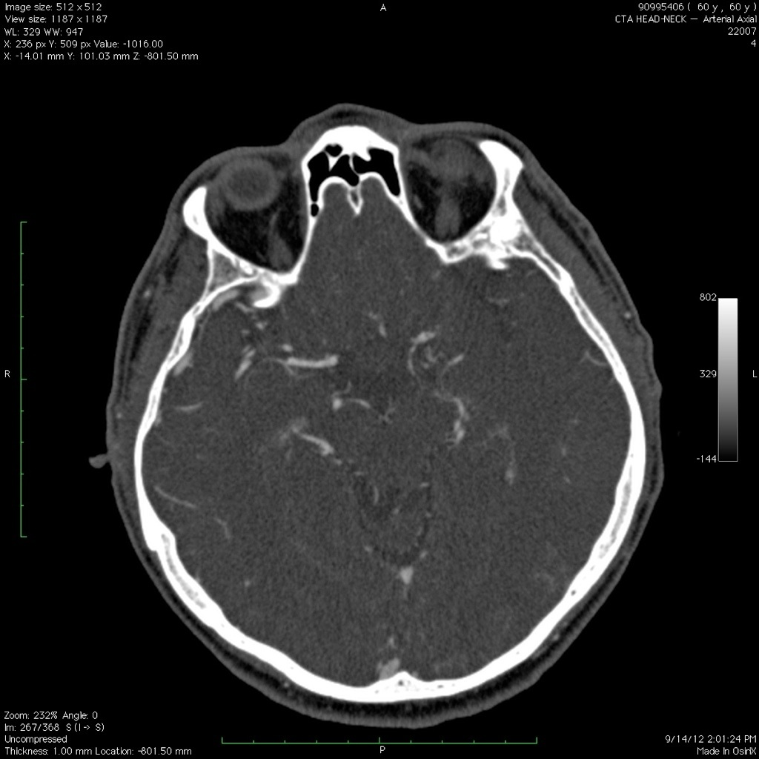

Slide 52
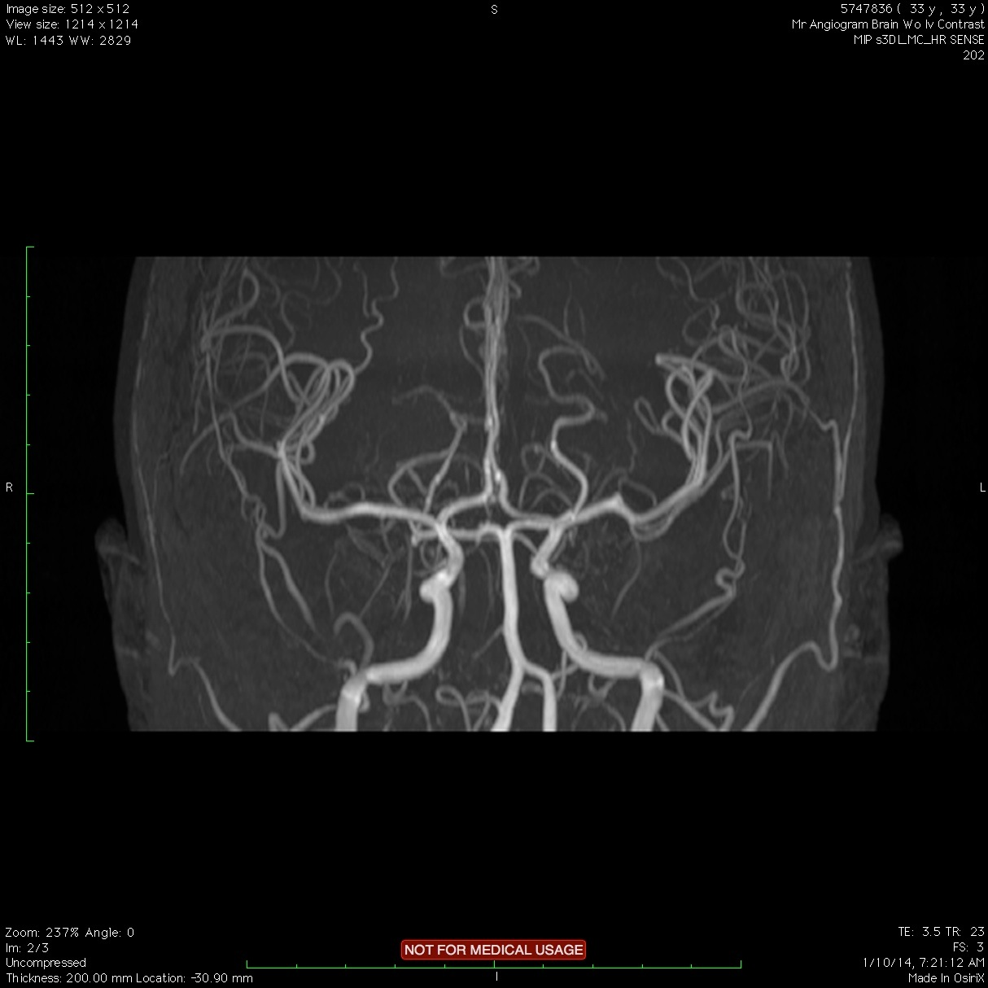
Big MCA syndromes

Slide 53
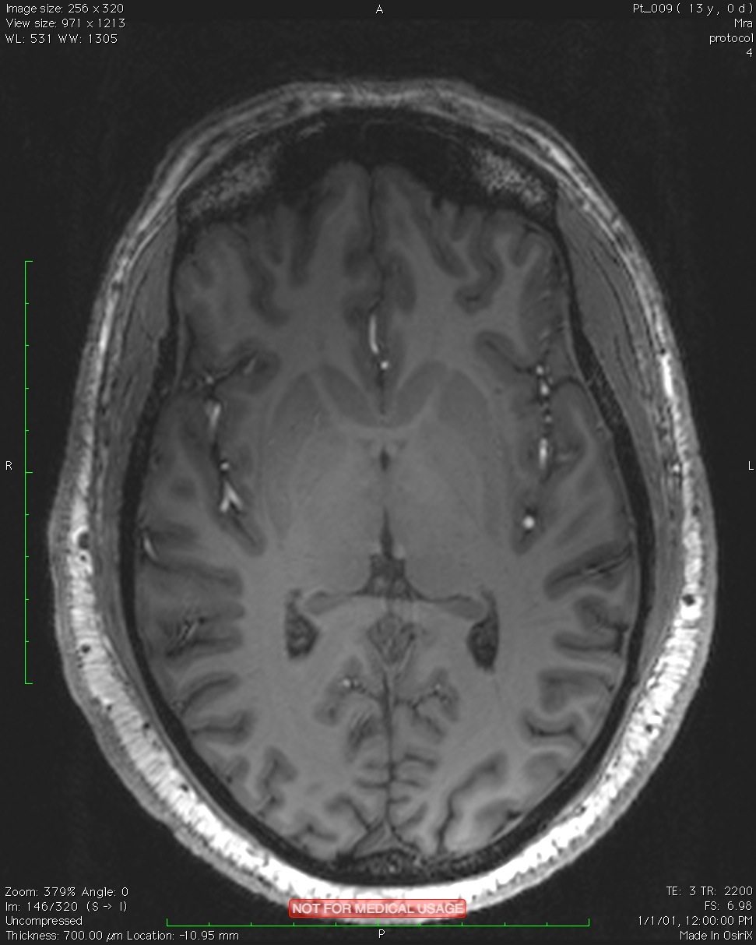
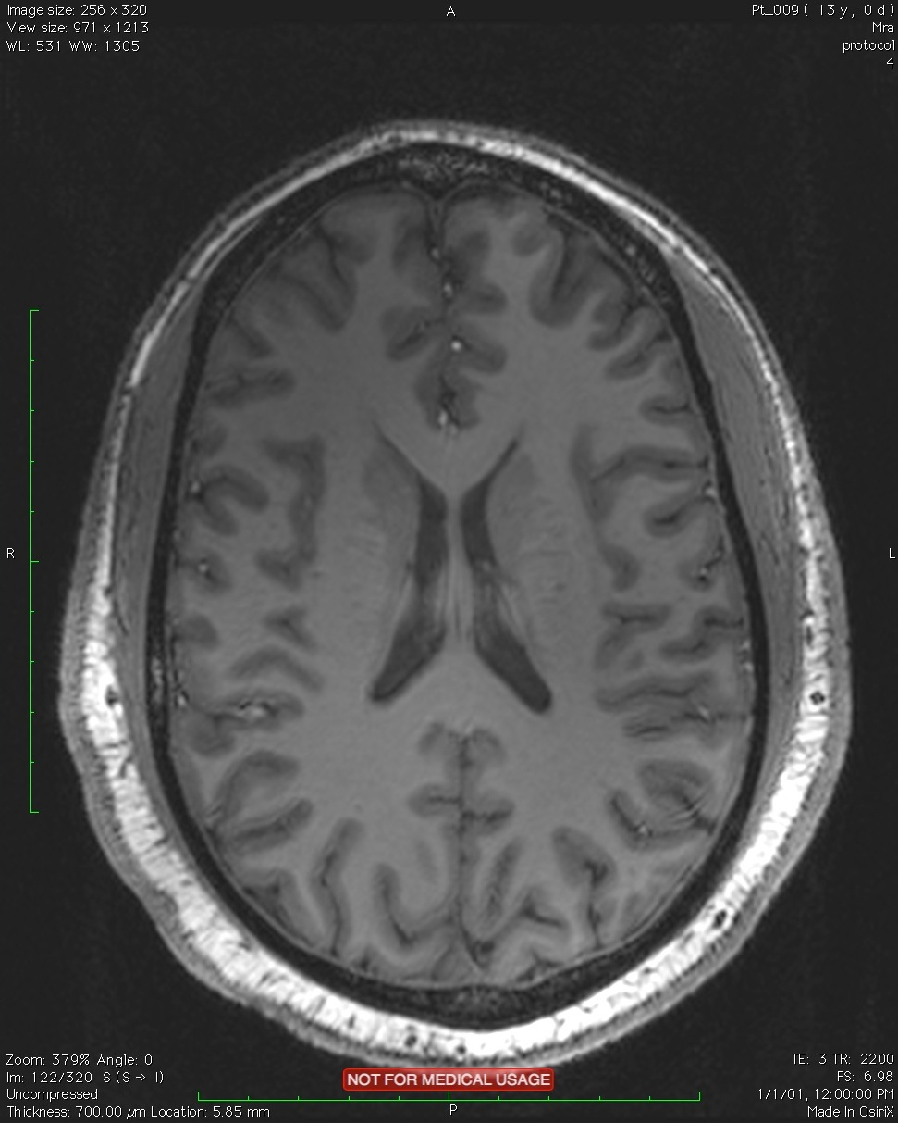
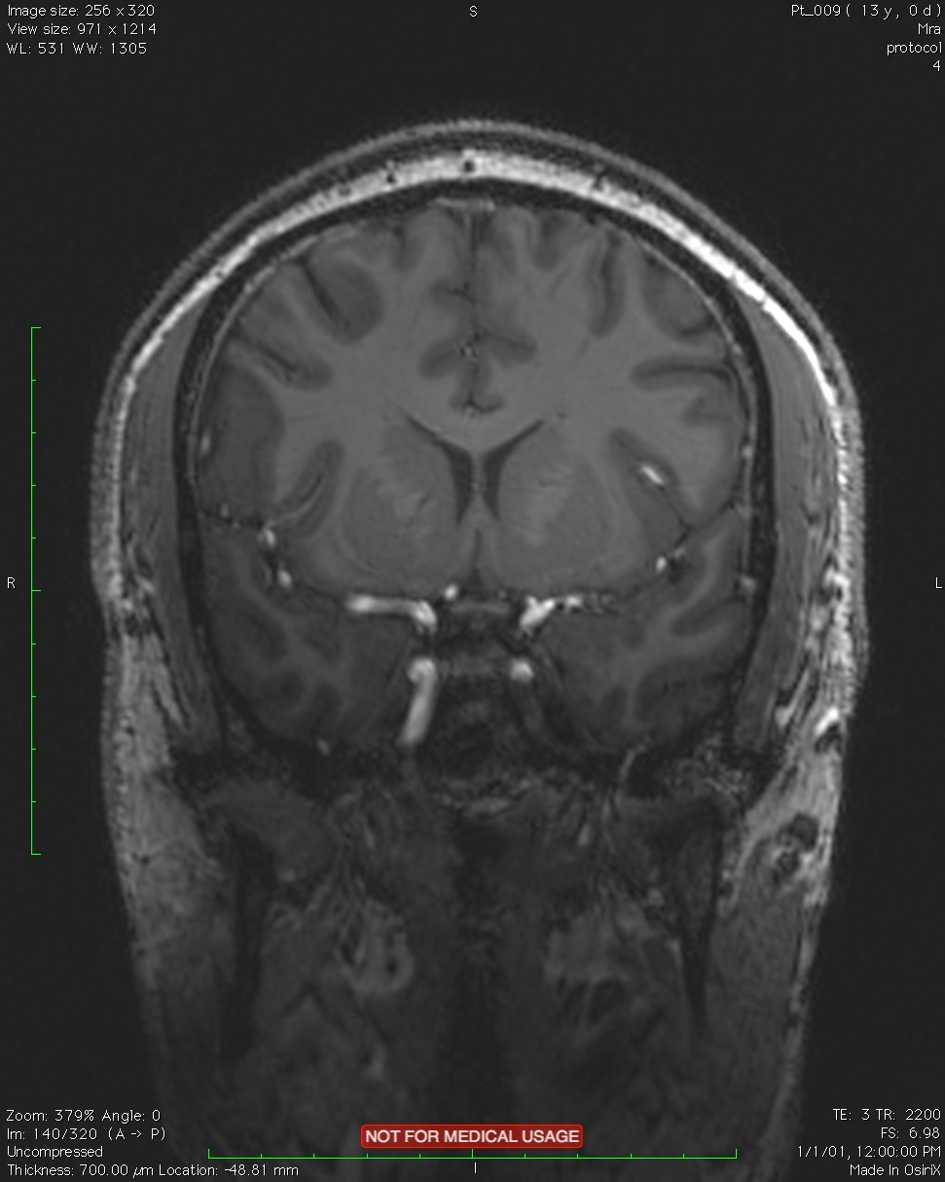
Big MCA syndromes

Slide 54
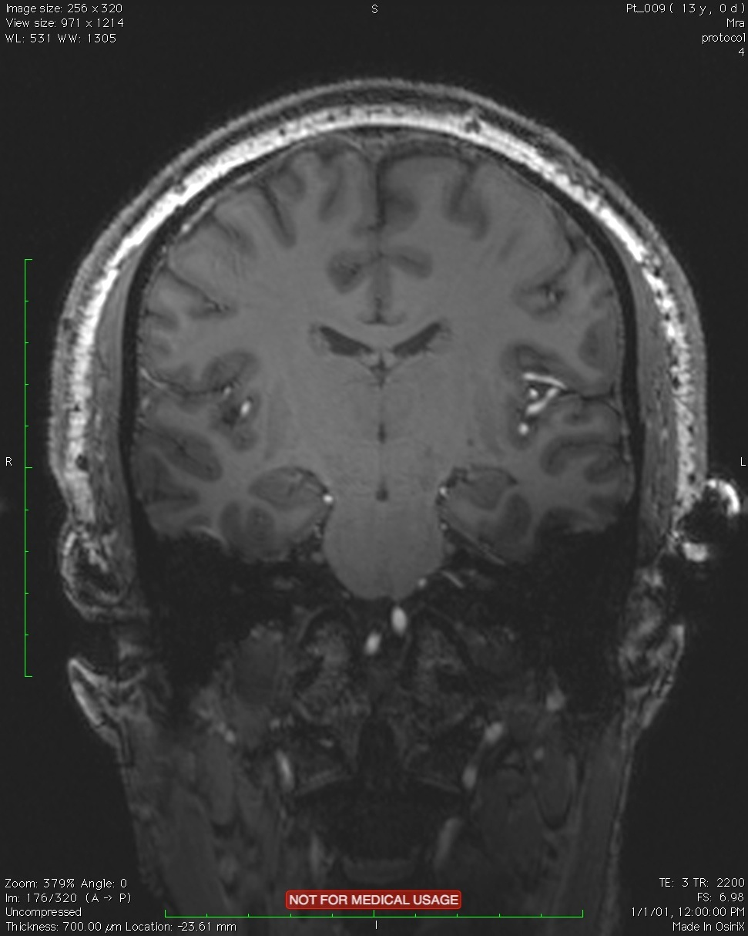
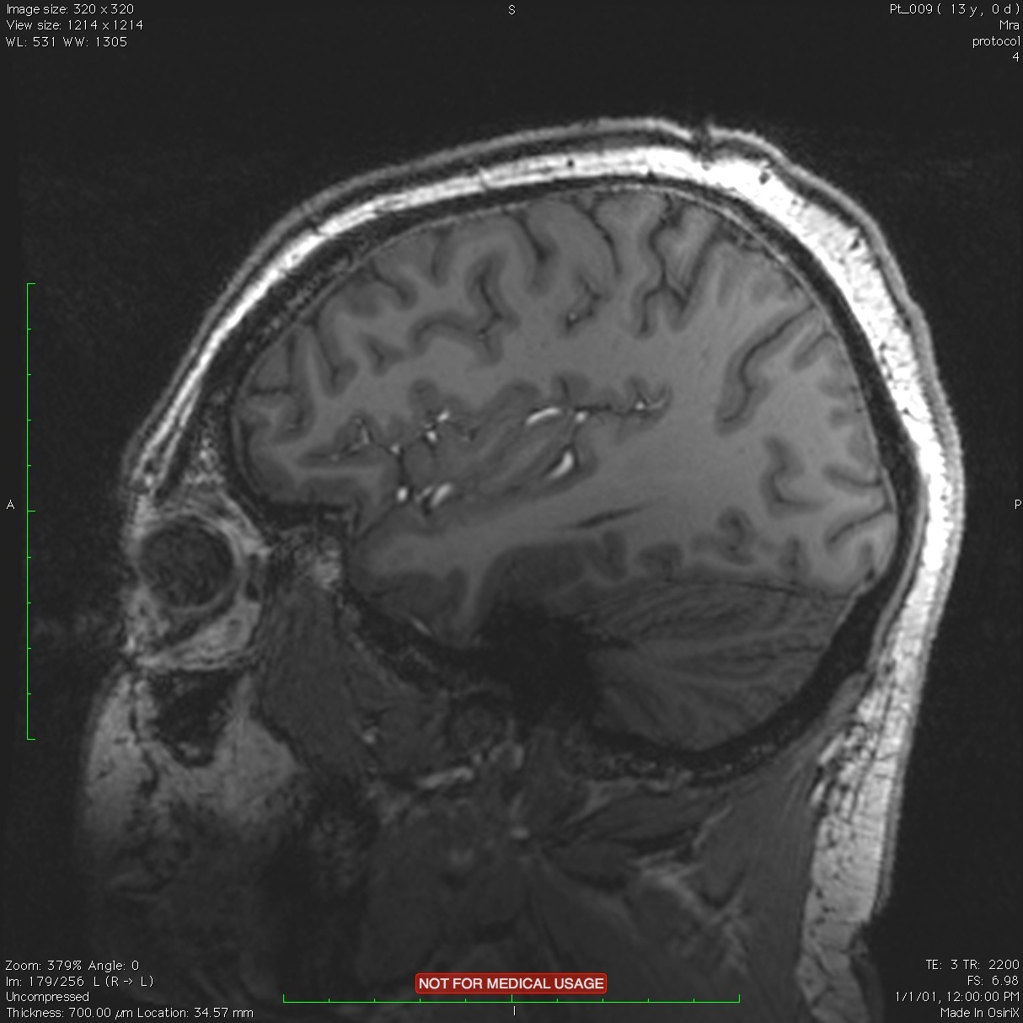

MCA syndrome

Slide 55
MCA Syndrome
Contralateral Gaze palsy
Contralateral hemiparesis
Spacial neglect (extinction)
Homonymous hemianopia
Aphasia

Slide 56
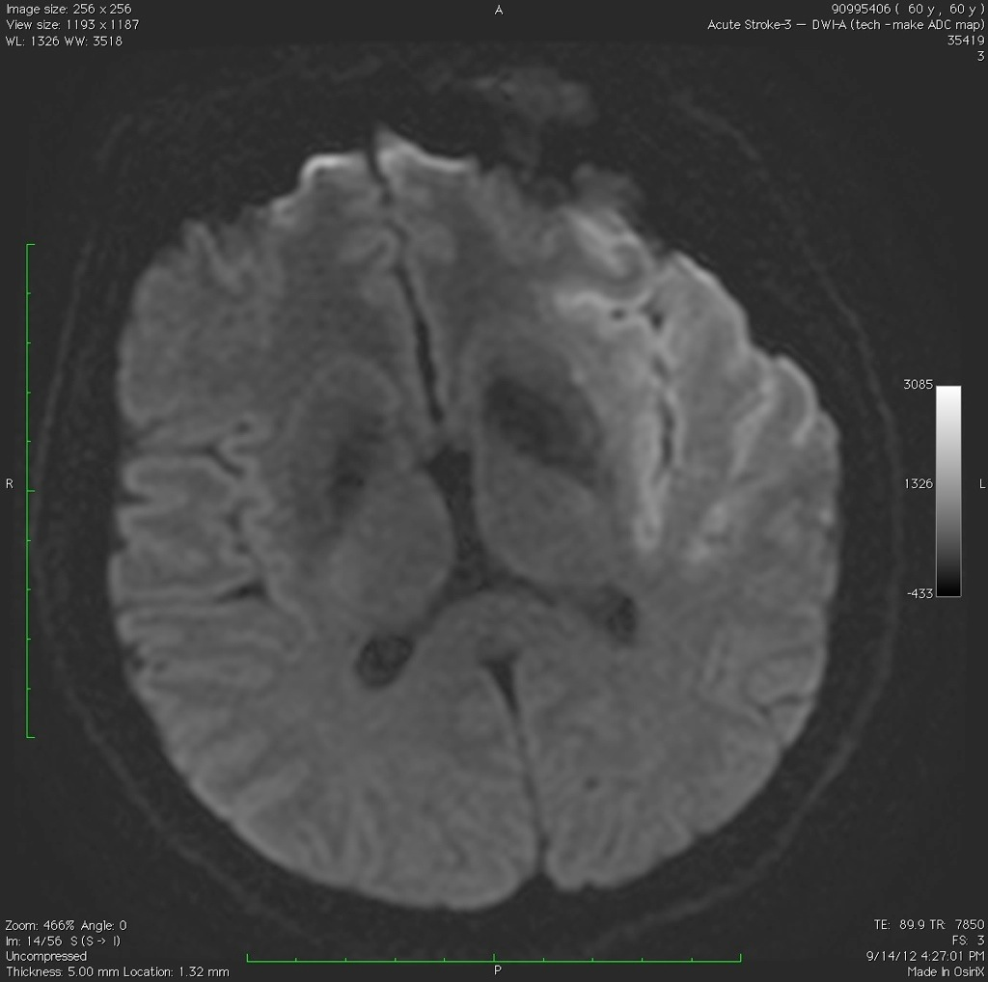
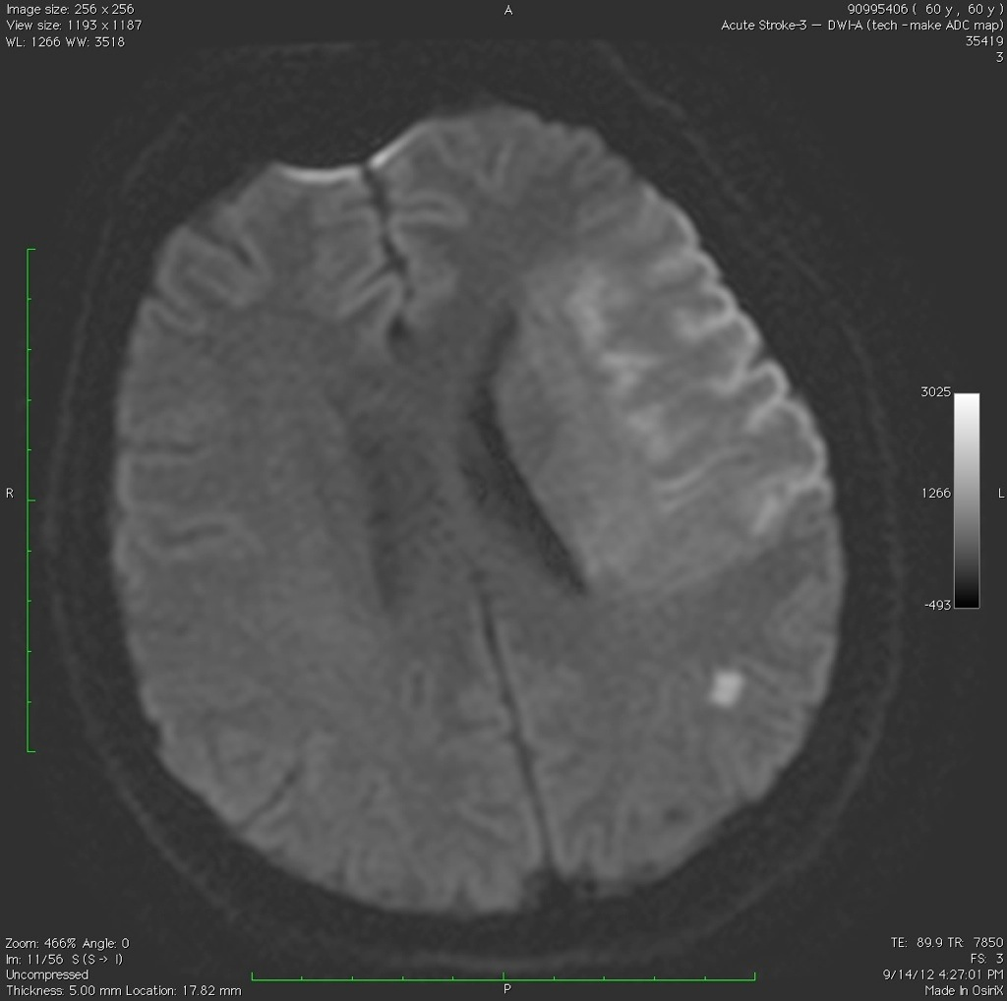

Slide 57
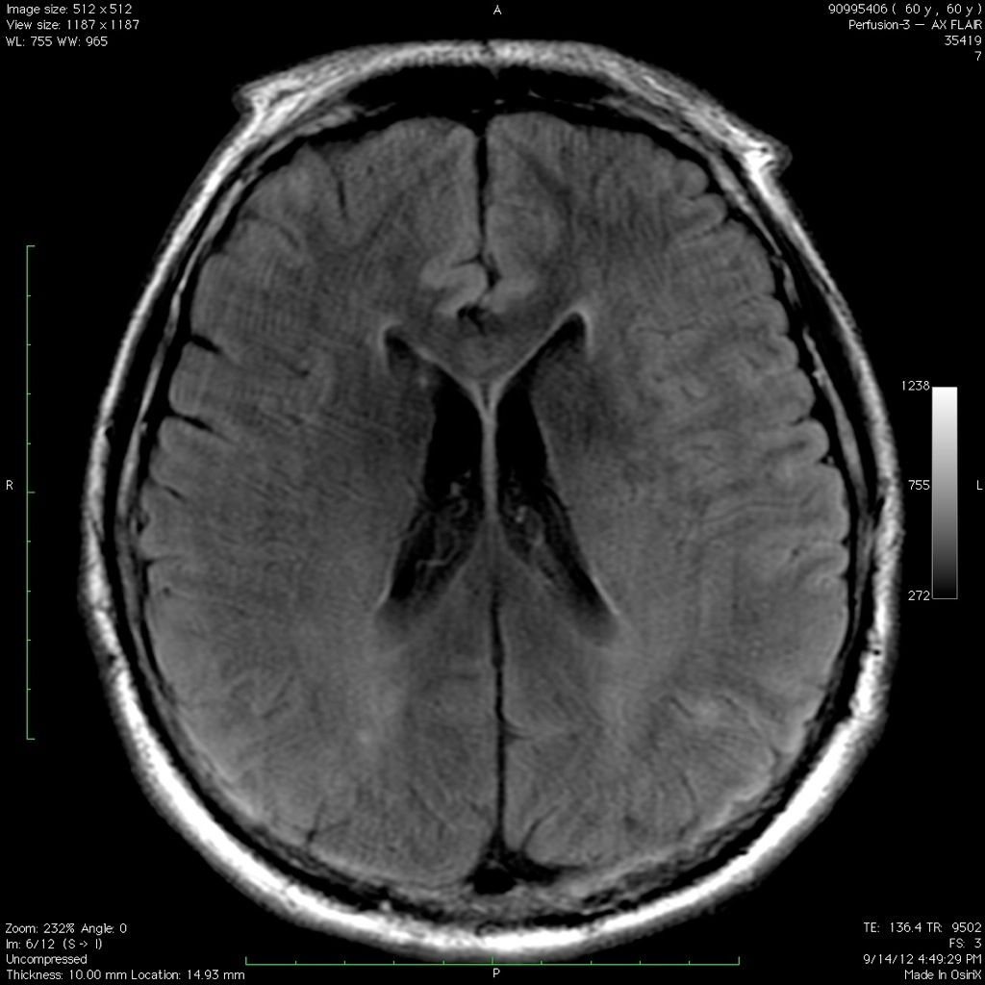

Slide 58
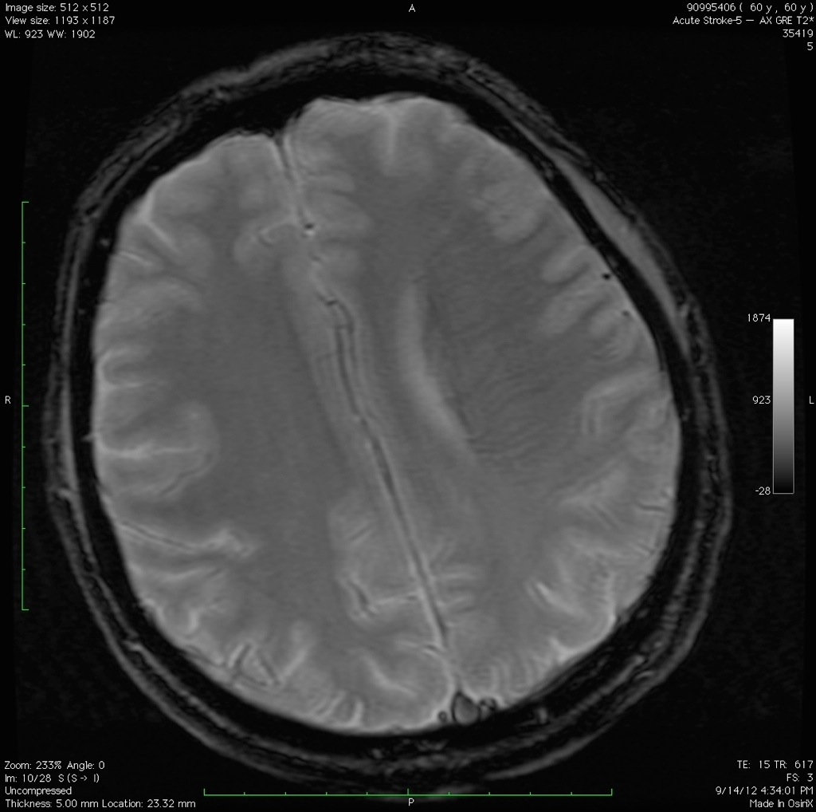

Slide 59
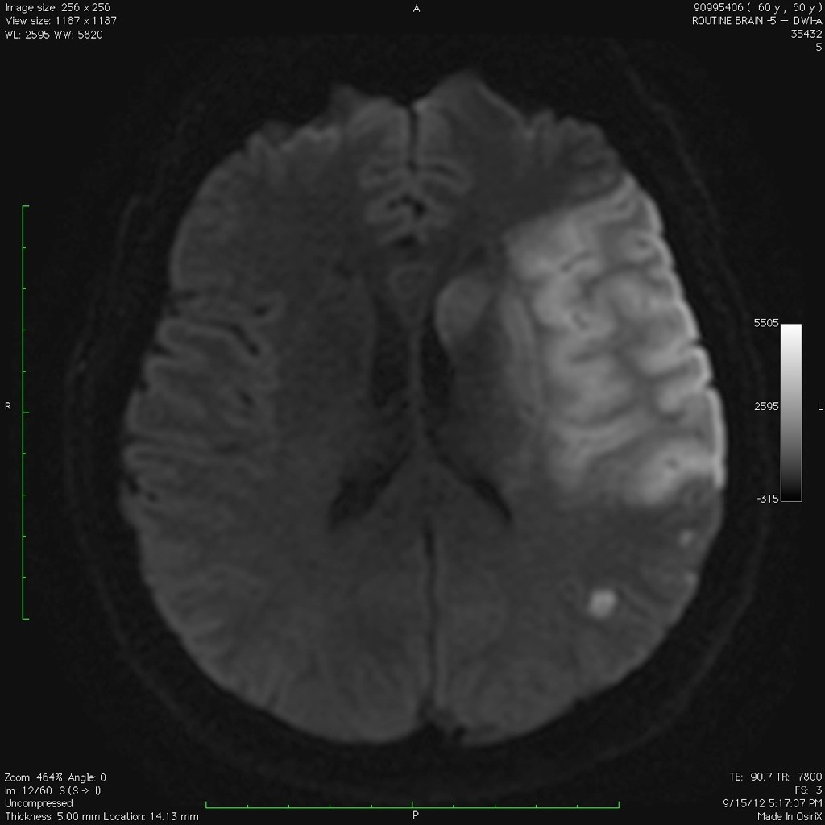
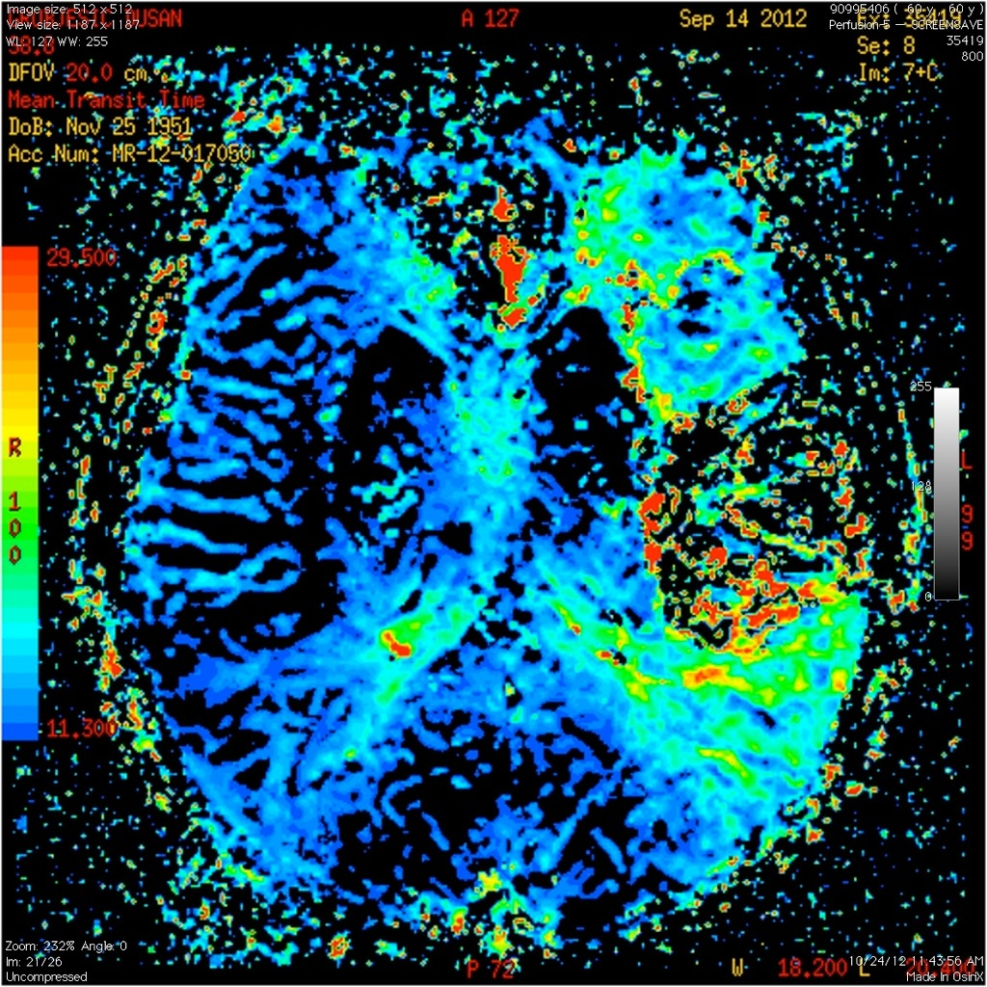
The ischemic penumbra

Slide 60

Parasylvian Syndrome

Slide 61
Parasylvian Syndrome

Slide 62
Parasylvian Syndrome
Contralateral hemiplegia, face and arm>leg
Contralateral hemisensory loss, face and arm
Conductive aphasia
Apraxia
Constructional dyspraxia
Gerstmann Syndrome

Slide 63
Superior Division Syndrome

Slide 64

Superior Division Syndrome

Slide 65
Superior Division Syndrome

Slide 66
Superior Division
Contralateral hemiparesis
Contralateral gaze palsy
Expressive aphasia

Slide 67
Inferior division syndrome

Slide 68
Inferior division syndrome

Slide 69
Inferior division syndrome
Contralateral homonymous hemianopsia or upper quadrantanopsia
Receptive aphasia
Constructional Apraxia
Spatial neglect

Slide 70
Code stroke
Rapid identification of a person who has clinical signs of stroke
Rapid assessment and treatment
IV thrombolysis < 3 hour window
IV thrombolysis < 4.5 hour window
Thrombectomy < 6 hours window
Thrombectomy in 6-24 hour window
Indications for IV thrombolysis
Contraindications for IV thrombolysis
Education for patients and family regarding risks and benefits for IV thrombolysis
Management of post thrombolysis complications and the deteriorating neurologic patient

Slide 71
Time is brain!!!
 | Neurons Lost | Synapses Lost | Myelinated Fibers Lost | Accelerated Aging
Per Stroke | 1.2 billion | 8.3 trillion | 7140 km/4470 miles | 36 years
Per Hour | 120 million | 830 billion | 714 km/447 miles | 3.6 years
Per Minute | 1.9 million | 14 billion | 12 km/7.5 miles | 3.1 weeks
Per Second | 32000 | 230 million | 200 meters/218 yards | 8.7 hours
Saver, Jeffery. Time Is Brain--Quantified. Stroke 2006;37;263-266.

Slide 72
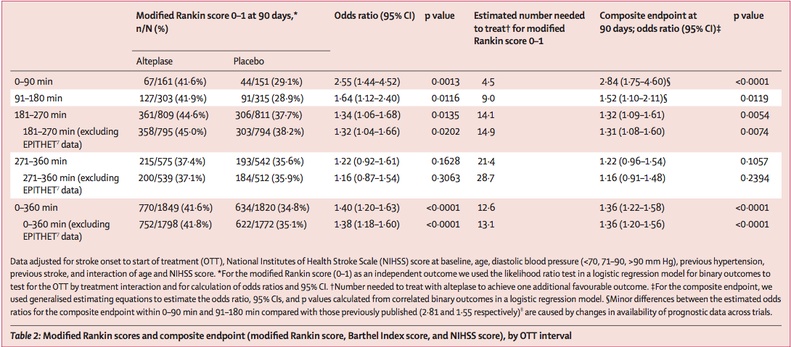
Lees K et al. Time to treatment with intravenous alteplase and outcome in stroke: an updated pooled analysis of ECASS, ATLANTIS, NINDS and EPITHET trials. Lancet 2010; 375:1695-703.

Slide 73
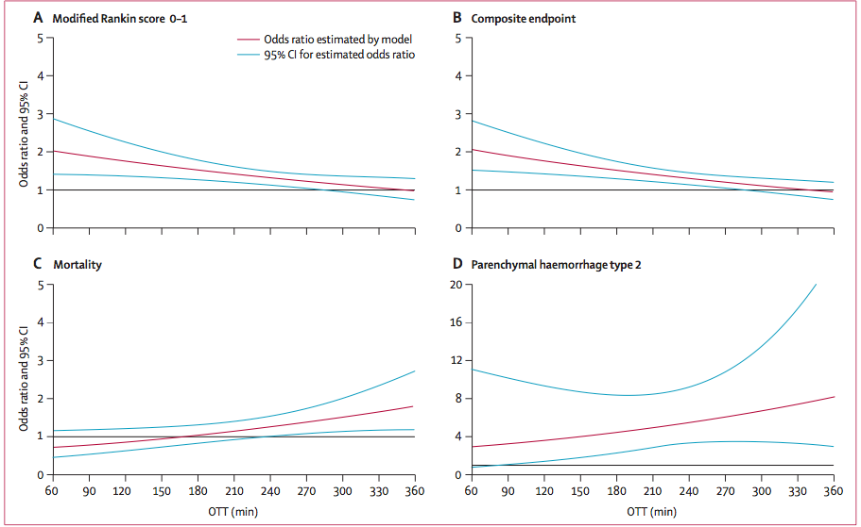
Lees K et al. Time to treatment with intravenous alteplase and outcome in stroke: an updated pooled analysis of ECASS, ATLANTIS, NINDS and EPITHET trials. Lancet 2010; 375:1695-703.

Slide 74
IV thrombolysis, what’s new?
Alteplase has been the mainstay of ischemic stroke IV thrombolysis
Tenecteplase is a modified tissue type plasminogen activator named after 3 mutation abbreviation sites T103N, N1170 and KHRR that has 14 times greater fibrin specific specificity, 10 times greater conservation of fibrin and 80 times great resistance to plasminogen activator inhibitor 1 activity

Slide 75
IV thrombolysis, what’s new?
Tenecteplase is non inferior (NOR-TEST 3)to alteplase with similar outcomes and hemorrhage profile (Lancet Neurol 2017; Oct 16:781-788)
Tenecteplase may be superior to alteplase in combination with mechanical thrombectomy in large artery stroke patients > 4.5 hours after last normal, greater reperfusion/functional outcomes (EXTEND IA TNK (NEJM 2018;378:1573-82)

Slide 76
IV thrombolysis, what’s new?
Tenecteplase in meta-analysis is proving non-inferior, easier to use (one time bolus) and less expensive trend amount Vascular Neurologist to adopts TNK (Saver et al. Stroke 2019;50:2156-2162 and Warach et al Stroke 2020;51:3440-3451)

Slide 77
Large Artery Occlusion
MR Rescue uses a favorable penumbral pattern (low ischemic core (< 90ml), large penumbra and mechanical thrombectomy (MERCI reserver device) with no improvement in mortality or functional outcomes (mRS 0-2) (NEJM 2013;368:914-23)

Slide 78
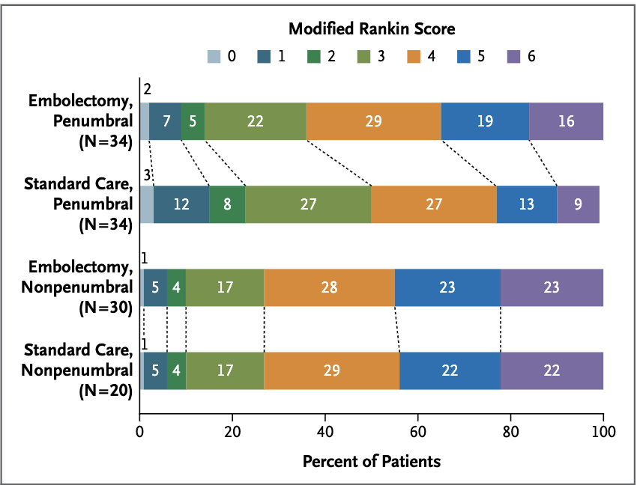
NEJM 2013;368:914-23

Slide 79
Large Artery Occlusion
MR CLEAN trial demonstrated that mechanical thrombectomy with a stent reserver device in acute ischemic stroke caused by proximal intracranial occlusion administered in < 6 hours was safe and effective (improved functional independence defined by mRS 0-2, 32.6% vs 19.1% in medical group (NEJM 2015; 372: 11-20)

Slide 80
Large Artery Occlusion
DAWN trial demonstrated the using multimodal imaging with a small ischemic core and a large penumbra and a proximal anterior circulation large vessel occlusion, mechanical thrombectomy can be expanded to the 6-24 hour window ( N Engl J Med 2018; 378:11-2)
Rate of functional independence (mRS 0-2) was 49% in the thrombectomy group and 19% in the medical management group

Slide 81
DAWN
Occlusion of the intracranial carotid artery, first segment of the middle cerebral artery or both
Group A ≥ 80 years, NIHSS ≥10, infarct core <21 ml
Group B < 80 years, NIHSS ≥10, infarct core < 31 ml
Group C < 80 years, NIHSS ≥20, infarct core 31 ml to <51 ml

Slide 82
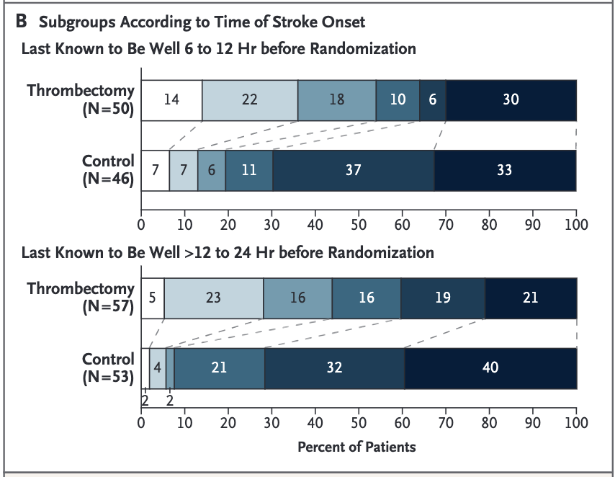
N Engl J Med 2018; 378:11-2

Slide 83
Large Artery Occlusion
DEFUSE 3 expand treatment from 6-16 hours using multimodal imaging, with ischemic core < 70 ml, penumbra ration of 1.8 for proximal large artery occlusion (intracranial ICA and proximal M1) with functional independence of 45% in thrombectomy group vs 17% in the medical group (NEJM 2018; 378: 708-18)

Slide 84
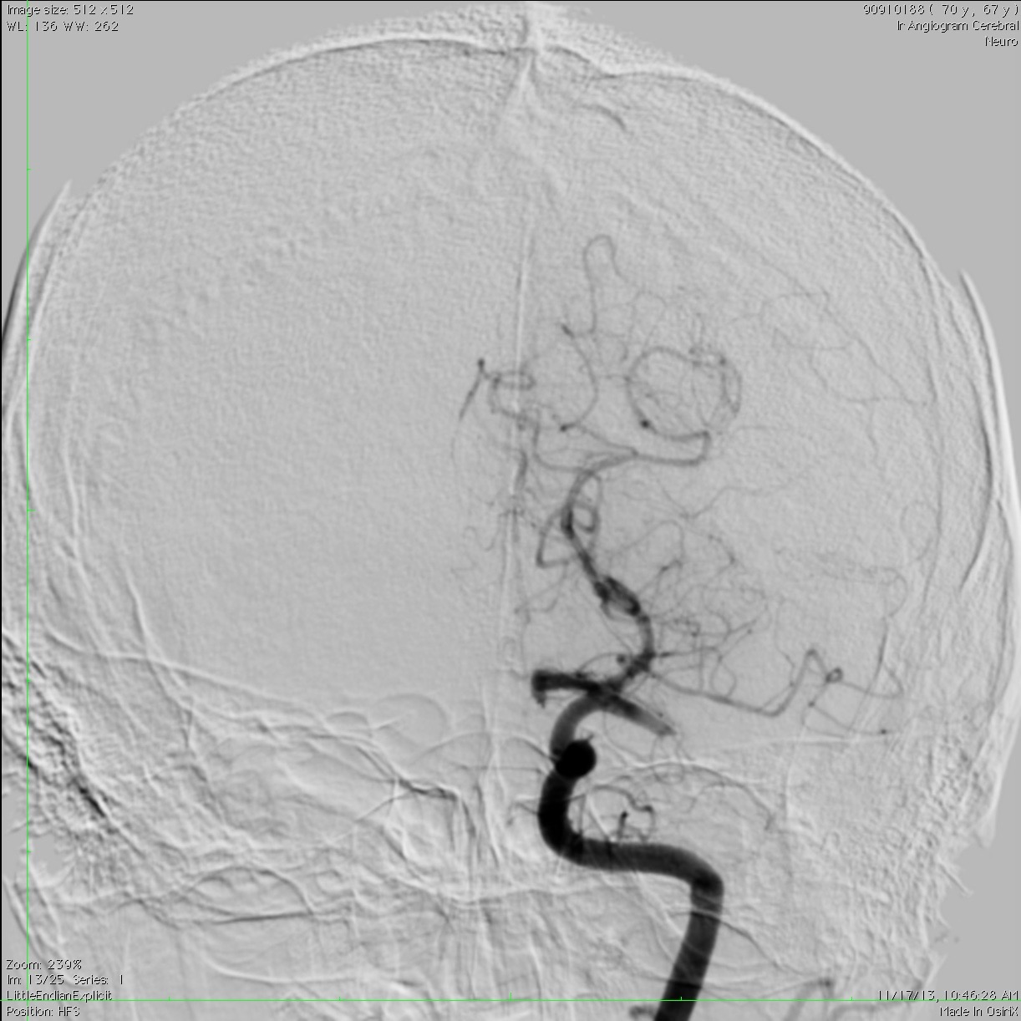
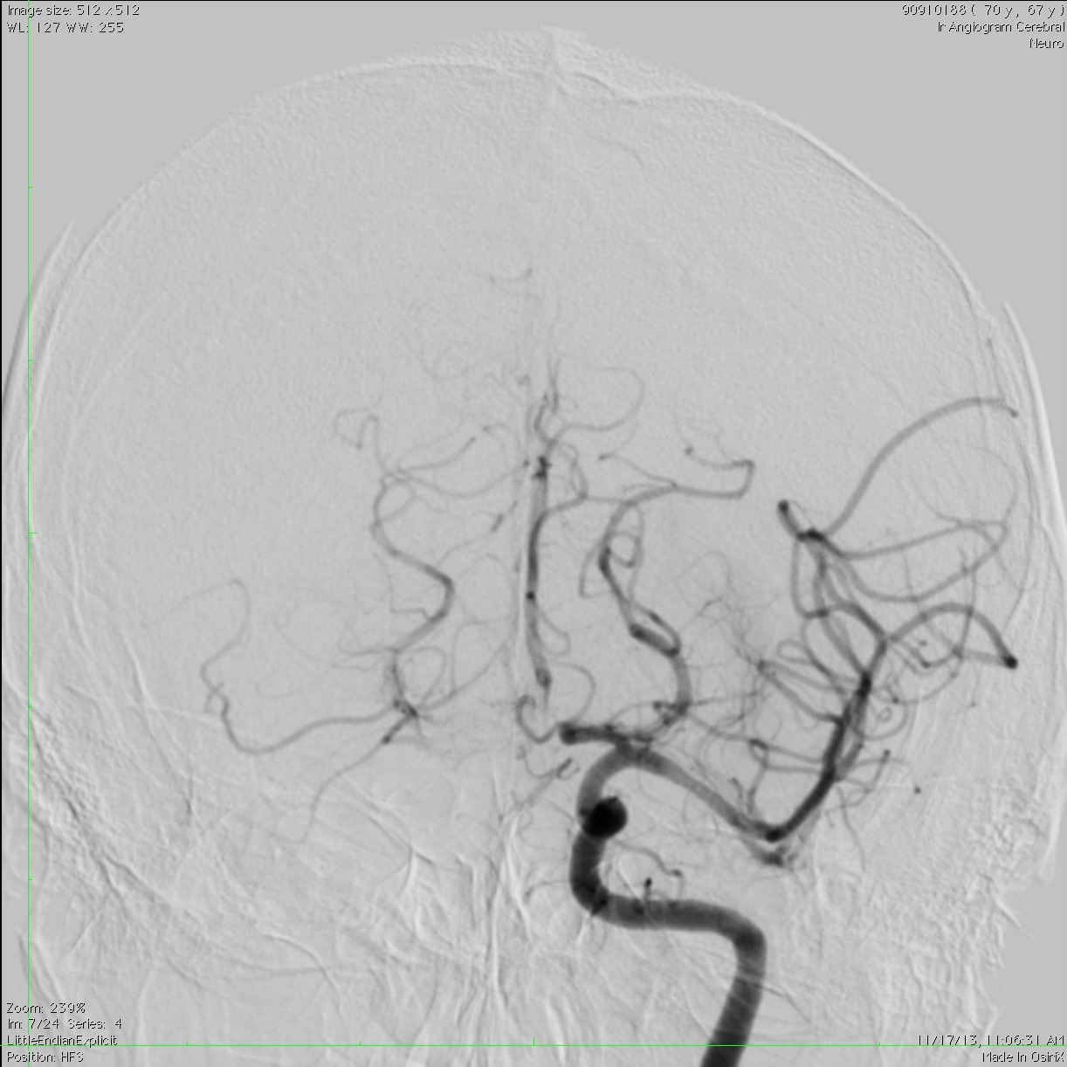

Slide 85
Thrombectomy in basilar artery occlusion
BASICS study evaluated mechanical thrombectomy of basilar occlusion <6 hours from LKW, (78.6% of the thrombectomy group and 79.5% of medical group received alteplase. No significant difference in mortality, favorable outcome (mRS 0-3)between groups
44.2% favorable outcome in thrombectomy group vs 37.7% in medical group
4.5% symptomatic ICH in thrombectomy group vs 0.7% in medical group
Mortality was 38.3% vs 43.2% in the thrombectomy vs medical group
NEJM 2021;384:1910-20

Slide 86
Secondary prevention
Dual anti platelet agents vs single anti platelet agent
Cerebral artery stenting
Cardiac loop monitoring

Slide 87
Dual Antiplatelet agents
Long term use of dual antiplatelert agents is not advised
Short term use has become general practice

Slide 88
Antiplatelet agents
Aspirin
Aggrenox
Clopidogrel
Ticagrelor
Boceprevir
Prasugrel
Eptifibatide
Vorapaxar

Slide 89
Match trial
MATCH trial demonstrated no significant benefit of combination therapy
There was a 1.3% absolute increase in life-threatening bleeding.
Diener HC, Bogousslavsky J, Brass L et al. Aspirin and clopidogrel compared with clopidogrel alone after recent ischaemic stroke or transient ischaemic attacks in high-risk patients (MATCH):randomized, double-blind, placebo-controlled trial. Lancet 2004; 364:331-37.

Slide 90
Match trial
 | Number with event, asa + clopidogrel | Number with event, placebo + clopidogrel | Absolute risk reduction | Relative risk reduction | p
Myocardial infarction, stroke and vascular death | 445 (12%) | 473 (12%) | 0.72% | 5.9% | 0.36
MI | 73 (2%) | 68 (2%) | -0.13% | -7.7% | 0.66
Stroke | 309 (8%) | 333 (9%) | 0.62% | 7.1% | 0.353
Vascular death | 124 (3%) | 121 (3%) | -0.08% | -2.4% | 0.854
Major bleeding | 73 (2%) | 22 (1%) |  |  | <0.0001
Minor bleeding | 120 (3%) | 39 (1%) |  |  | <0.0001
Diener HC, Bogousslavsky J, Brass L et al. Aspirin and clopidogrel compared with clopidogrel alone after recent ischaemic stroke or transient ischaemic attacks in high-risk patients (MATCH):randomized, double-blind, placebo-controlled trial. Lancet 2004; 364:331-37.

Slide 91
SPS 3
No significant difference in stroke prevention
Almost double risk of major hemorrhage (2.1 % per year combination vs 1.1% per year aspirin alone)
SPS-3 Investigators. Effects of Clopidogrel Added to Aspirin in patients with Recent Lacunar Stroke. NEJM 2012; 367:817-825.

Slide 92
SPS 3
Outcome | Aspirin plus placebo (rate %/yr) | Aspirin plus clopidogrel(rate %/yr) | P
All strokes | 2.7 | 2.5 | 0.48
Ischemic | 2.4 | 2 | 0.13
Hemorrhage | 0.25 | 0.42 | 0.15
Disabling or fatal | 0.78 | 0.84 | 0.79
TIA | 0.78 | 0.57 | 0.19
MI | 0.71 | 0.59 | 0.47
All deaths | 1.4 | 3.1 | 0.004
Probable vascular causes | 0.11 | 0.34 | 0.02
SPS-3 Investigators. Effects of Clopidogrel Added to Aspirin in patients with Recent Lacunar Stroke. NEJM 2012; 367:817-825.

Slide 93
POINT
Comparing aspirin and clopidogrel vs clopidogrel for high risk TIA (ABCD2 >4) or minor stroke (NIHSS <3)
Effect on a vascular event at 90 days, ischemic stroke, MI and ischemic vascular death
NEJM 2018; 379:215-225

Slide 94
POINT
12 hours of having a stroke (aspirin 50-325 mg; and clopidogrel 600 mg bolus and 75 mg daily
Stroke 5% of the clopidogrel plus aspirin and 6.5% in the aspirin alone (stroke, MI vascular death)
4.6% vs 6.3% for ischemic stroke alone
Most events occurred 7 days after randomization
NEJM 2018; 379:215-225

Slide 95
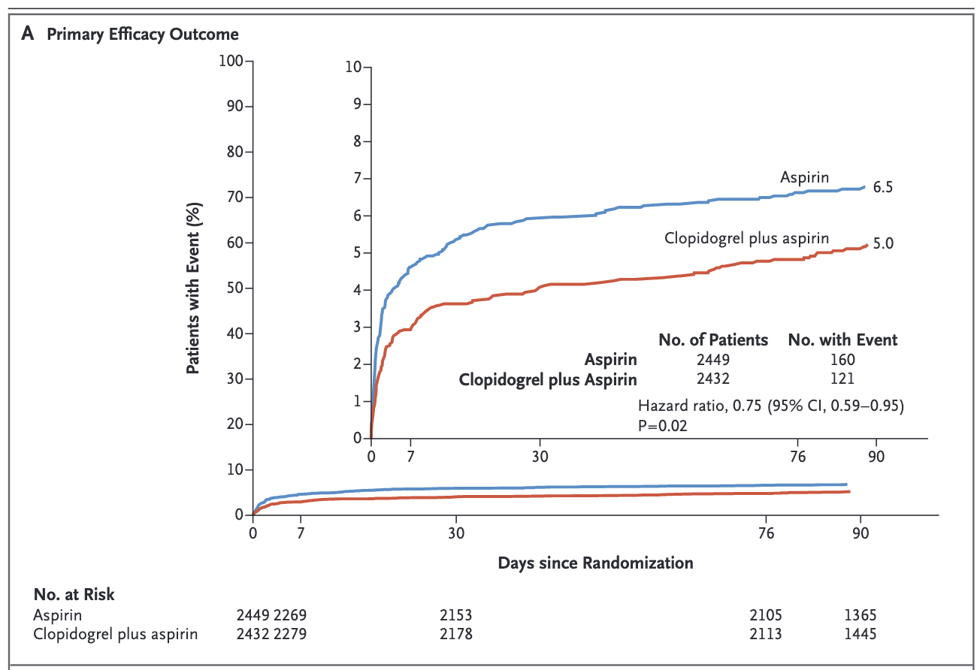
POINT
NEJM 2018; 379:215-225

Slide 96
Aspirin vs Ticagrelor
SOCRATES demonstarted no benefit of Ticagrelor over Asprin in secondary stroke prevention
5.8% (Stroke/MI) Ticagrelor vs 6.5% aspirin
NEJM 2016;375:35-43.

Slide 97
Aspirin plus Ticagrelor
THALES studies in patient with mild stroke (NIHSS ≤5) and no Thrombolysis or ERT 5% vs 6.3% (stroke/death)
Severe bleeding in 0.5% combination group vs 0.1% aspirin group
NEJM 2020;383:207-217

Slide 98
Stenting of intracranial arteries
SAMMPRIS study found that stenting of intracranial arteries was not benificial and had a high periprocedural complication rate
14.7% stroke and death rate in the stenting group vs 5.8% in the medical group
At 12 months primary end point (stroke/death) was 20% in the stenting group and 12.2% in the medical group
N Engl J Med 2011; 365:993-1003

Slide 99
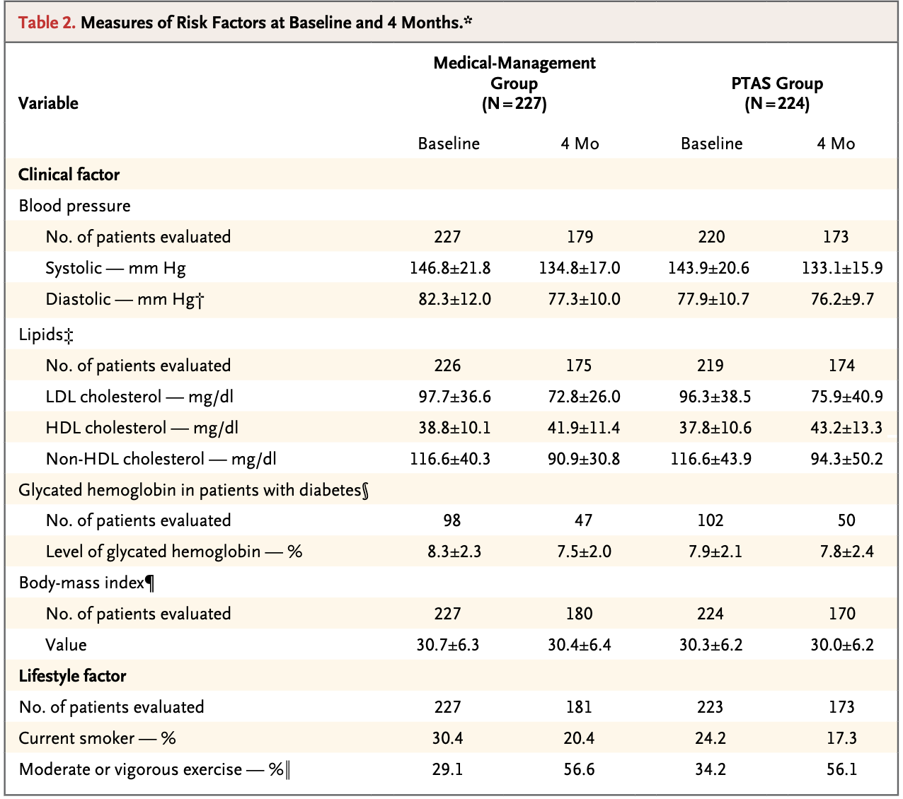
N Engl J Med 2011; 365:993-1003

Slide 100
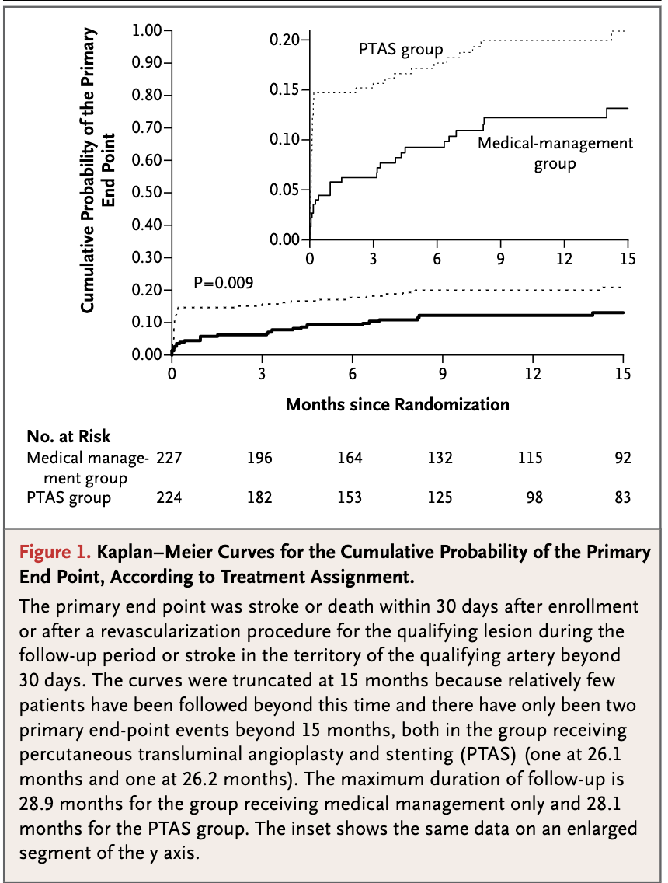

Slide 101
Stenting of intracranial arteries
WEAVE trial open label, uncontrolled, post market surveillance study demonstrated 2.6% periprocedural complication rate
No benefit was evaluated
Stroke. 2019;50:889–894

Slide 102
Stenting of intracranial arteries
WOVEN in the 1 year follow up to WEAVE
8.5% stroke/death rate
No control group
J Neurointerv Surg. 2021 Apr;13(4):307-310.

Slide 103
Summary
Mainstay of ICH treatment remains blood pressure control
Surgical evaluation and catheter based evaluation has not been proven beneficial
Transition from Alteplase to Tenecteplase for acute ischemic stroke Thrombolysis
Mechanical thrombectomy on all ischemic strokes with target occlusion (terminal ICA/M1) < 6 hours
6-24 hour technical thrombectomy in select cases with favorable imaging profile (small core, larger penumbra)
Early thrombectomy in basilar artery occlusion did not show unfit over alteplase/medical therapy

Slide 104
Summary
Long term dual anti platelet agent therapy for stroke prevention is not recommended
Select cases for short term dial anti platelet agents is recommended (NIHSS≤3 stroke and ABCD 2 ≥4 TIA’s)
Ticagrelor may be a new option for secondary stroke prevention
Stenting of intracranial arteries has not demonstrated benefit with open label studies showing decreased periprocedural complications

